Slide 1
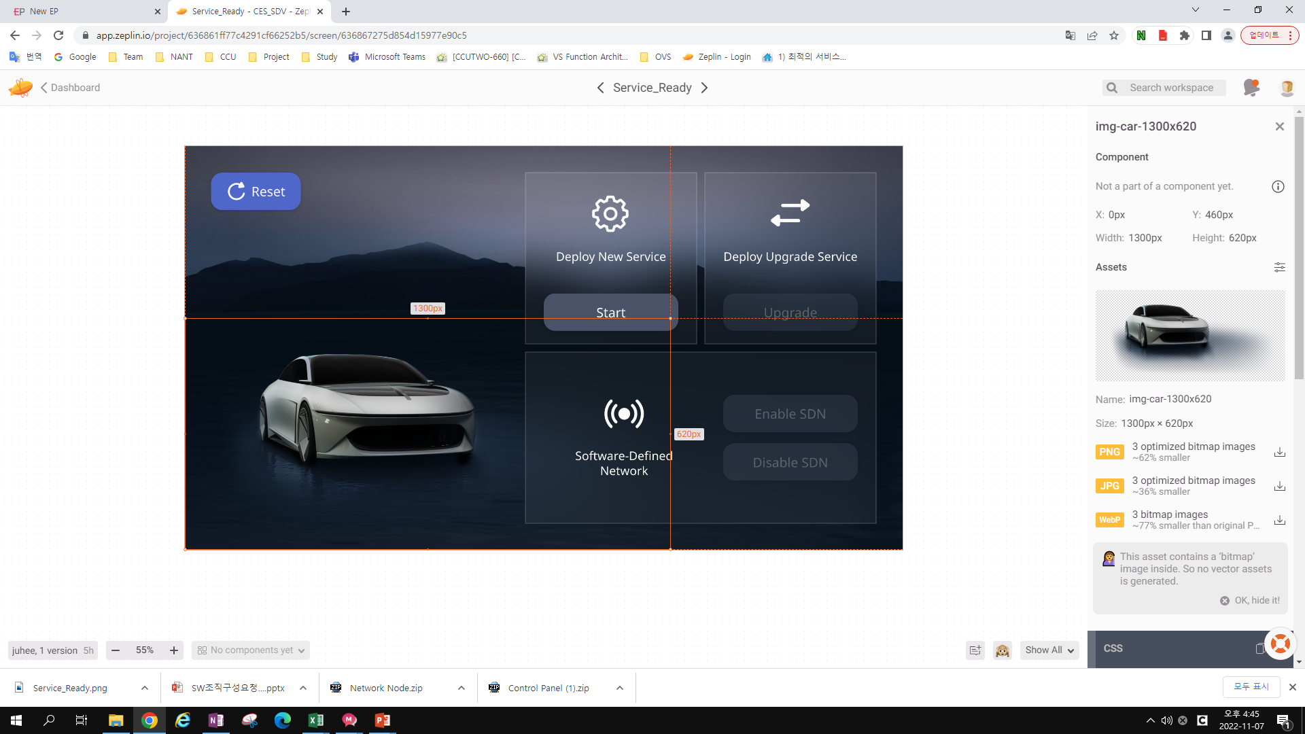

Slide 2
img.img-car-1300x620 {
width: 1300px;
height: 620px;
margin: 279px 90px 0 0;
object-fit: contain;
}
<!-- jpg -->
<img src="img/img-car-1300-x-620.jpg"
srcset="img/img-car-1300-x-620@2x.jpg 2x,
img/img-car-1300-x-620@3x.jpg 3x"
class="img-car-1300x620">
<!-- png -->
<img src="img/img-car-1300-x-620.png"
srcset="img/img-car-1300-x-620@2x.png 2x,
img/img-car-1300-x-620@3x.png 3x"
class="img-car-1300x620">
<!-- webp -->
<img src="img/img-car-1300-x-620.webp"
srcset="img/img-car-1300-x-620@2x.webp 2x,
img/img-car-1300-x-620@3x.webp 3x"
class="img-car-1300x620">

Slide 3
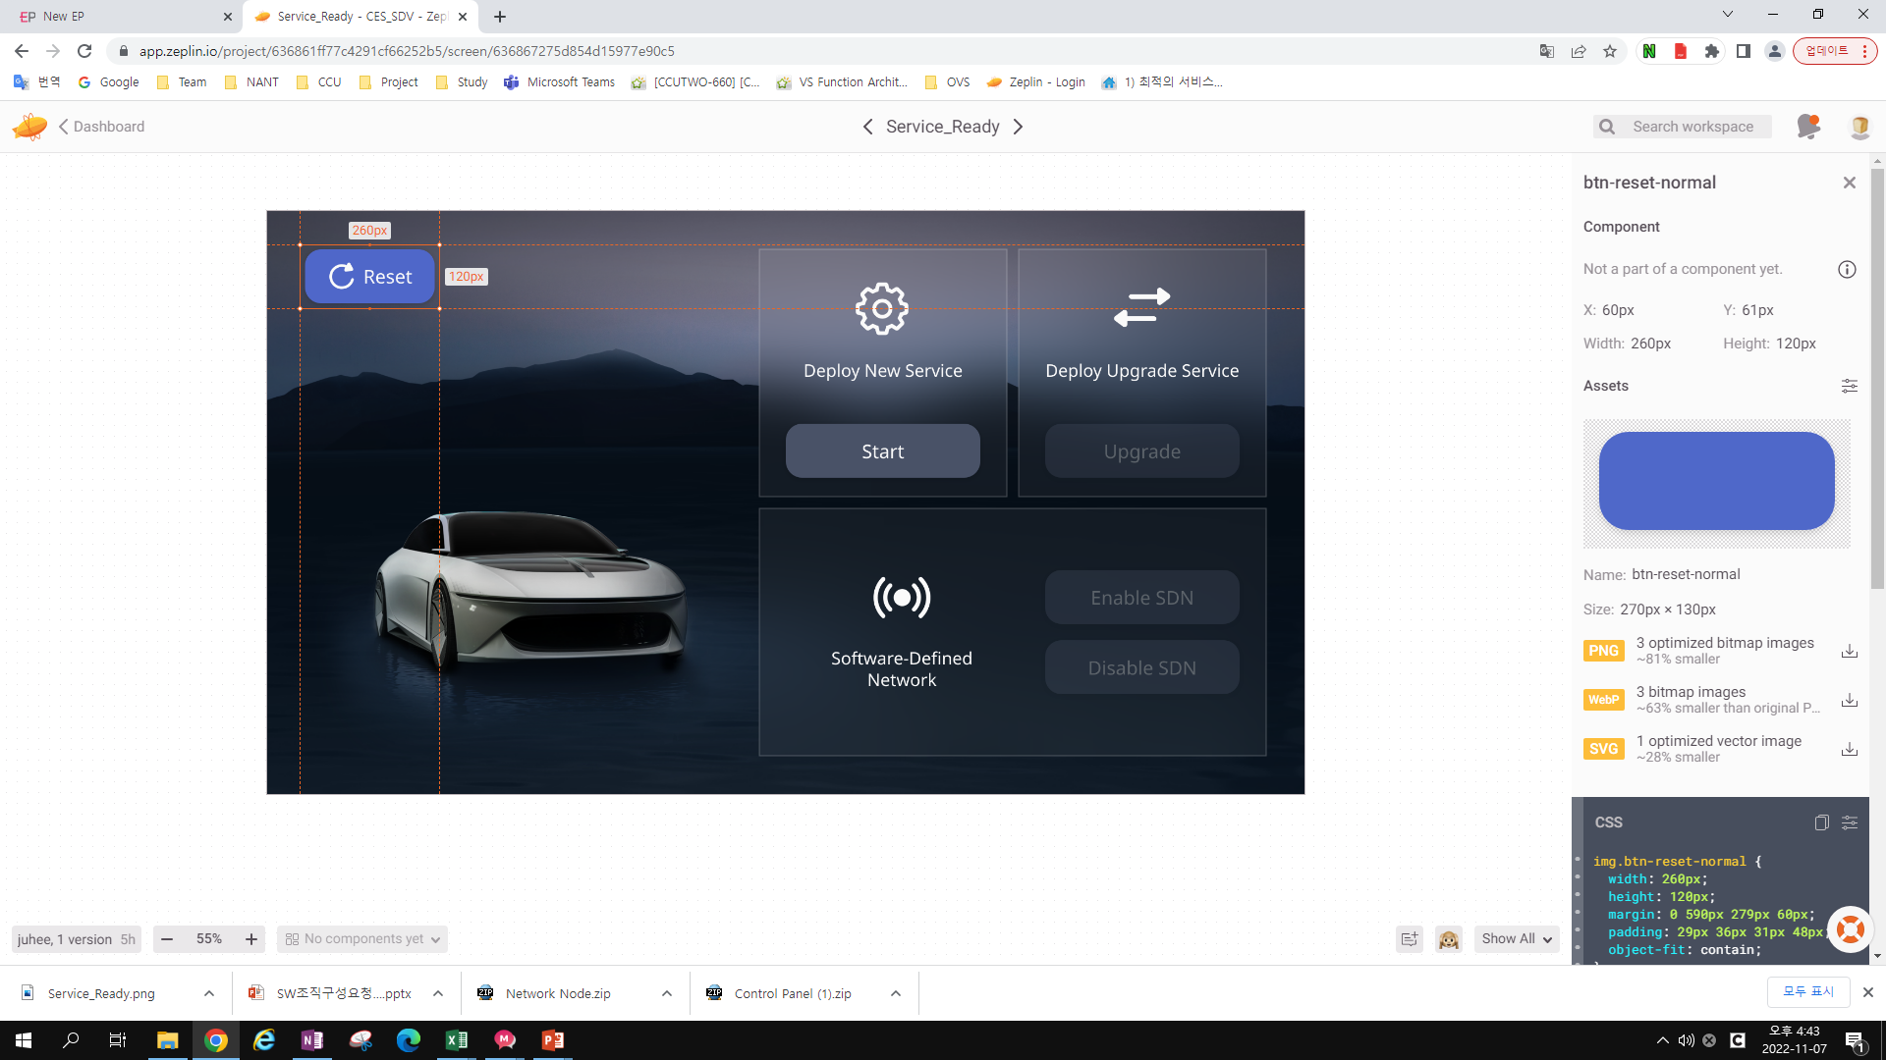

Slide 4
img.btn-reset-normal {
width: 260px;
height: 120px;
margin: 0 590px 279px 60px;
padding: 29px 36px 31px 48px;
object-fit: contain;
}
<!-- png -->
<img src="img/btn-reset-normal.png"
srcset="img/btn-reset-normal@2x.png 2x,
img/btn-reset-normal@3x.png 3x"
class="btn-reset-normal">
<!-- svg -->
<img src="img/btn-reset-normal.svg"
class="btn-reset-normal">
<!-- webp -->
<img src="img/btn-reset-normal.webp"
srcset="img/btn-reset-normal@2x.webp 2x,
img/btn-reset-normal@3x.webp 3x"
class="btn-reset-normal">

Slide 5
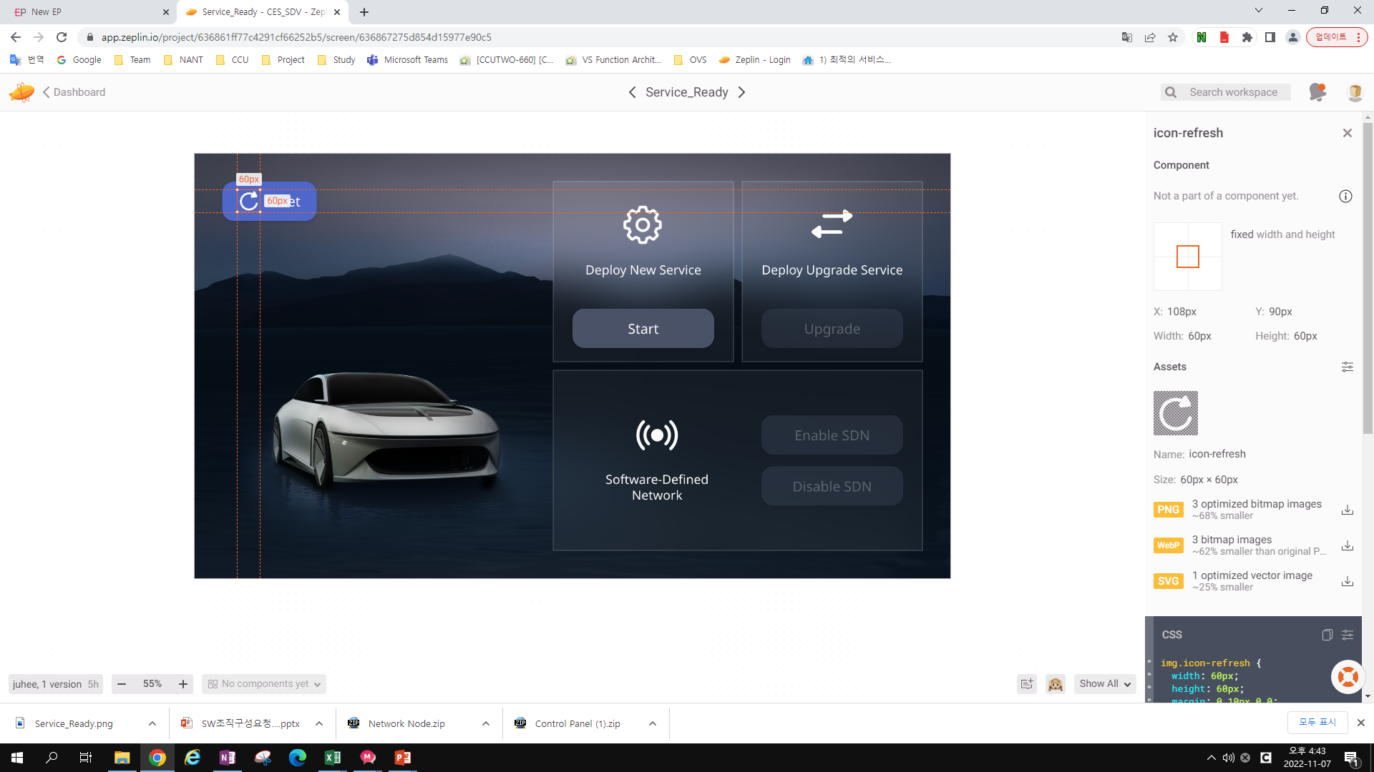

Slide 6
img.icon-refresh {
width: 60px;
height: 60px;
margin: 0 10px 0 0;
object-fit: contain;
}
<!-- png -->
<img src="img/icon-refresh.png"
srcset="img/icon-refresh@2x.png 2x,
img/icon-refresh@3x.png 3x"
class="icon-refresh">
<!-- svg -->
<img src="img/icon-refresh.svg"
class="icon-refresh">
<!-- webp -->
<img src="img/icon-refresh.webp"
srcset="img/icon-refresh@2x.webp 2x,
img/icon-refresh@3x.webp 3x"
class="icon-refresh">

Slide 7
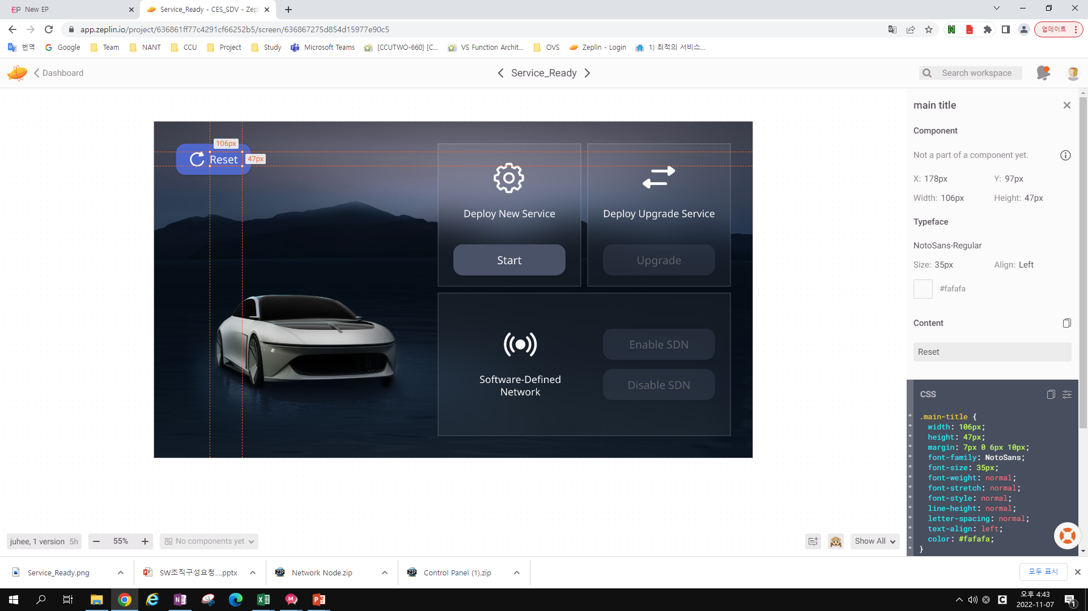

Slide 8
.main-title {
width: 106px;
height: 47px;
margin: 7px 0 6px 10px;
font-family: NotoSans;
font-size: 35px;
font-weight: normal;
font-stretch: normal;
font-style: normal;
line-height: normal;
letter-spacing: normal;
text-align: left;
color: #fafafa;
}
<span class="main-title">
Reset
</span>

Slide 9
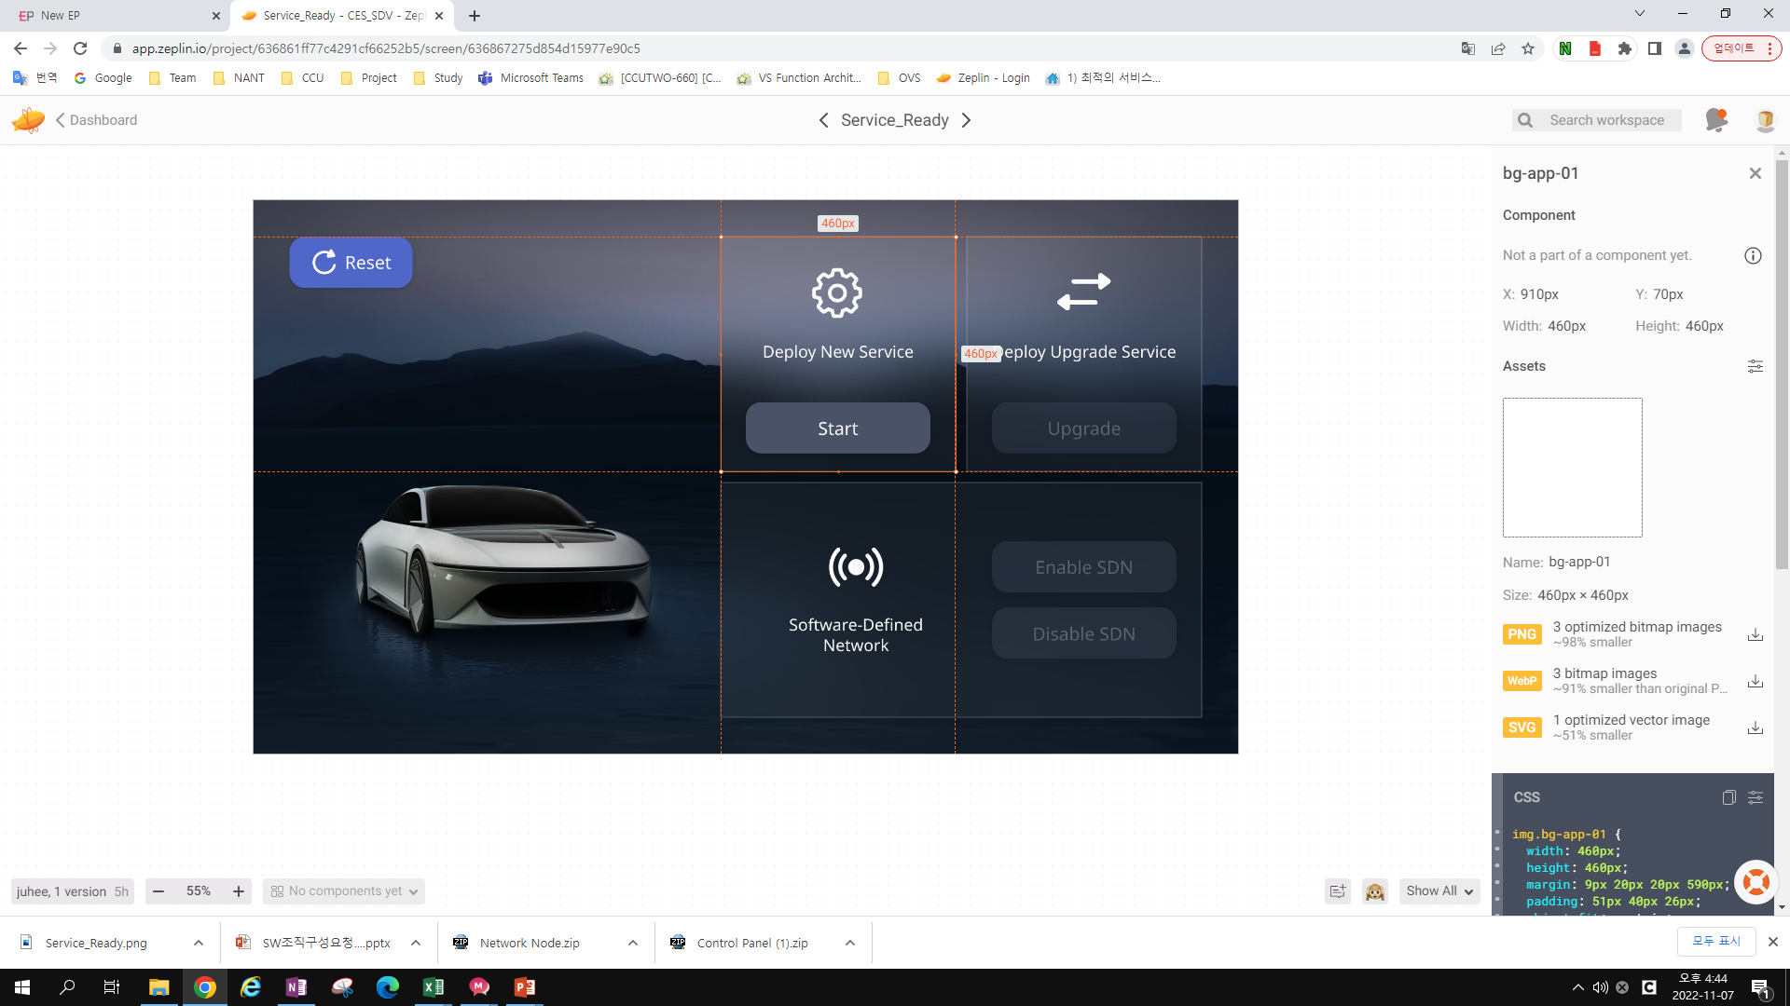

Slide 10
img.bg-app-01 {
width: 460px;
height: 460px;
margin: 9px 20px 20px 590px;
padding: 51px 40px 26px;
object-fit: contain;
}
<!-- png -->
<img src="img/bg-app-01.png"
srcset="img/bg-app-01@2x.png 2x,
img/bg-app-01@3x.png 3x"
class="bg-app-01">
<!-- svg -->
<img src="img/bg-app-01.svg"
class="bg-app-01">
<!-- webp -->
<img src="img/bg-app-01.webp"
srcset="img/bg-app-01@2x.webp 2x,
img/bg-app-01@3x.webp 3x"
class="bg-app-01">

Slide 11
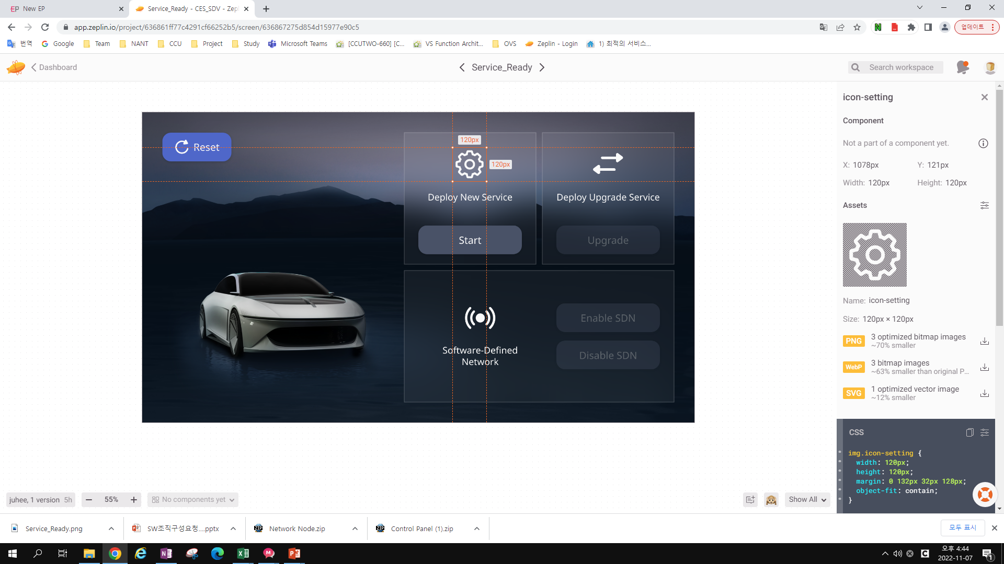

Slide 12
<!-- png -->
<img src="img/icon-setting.png"
srcset="img/icon-setting@2x.png 2x,
img/icon-setting@3x.png 3x"
class="icon-setting">
<!-- svg -->
<img src="img/icon-setting.svg"
class="icon-setting">
<!-- webp -->
<img src="img/icon-setting.webp"
srcset="img/icon-setting@2x.webp 2x,
img/icon-setting@3x.webp 3x"
class="icon-setting">
img.icon-setting {
width: 120px;
height: 120px;
margin: 0 132px 32px 128px;
object-fit: contain;
}

Slide 13


Slide 14
.Deploy-New-Service {
width: 360px;
height: 43px;
margin: 32px 10px 68px;
font-family: NotoSans;
font-size: 32px;
font-weight: normal;
font-stretch: normal;
font-style: normal;
line-height: 1.25;
letter-spacing: normal;
text-align: center;
color: #fafafa;
}
<span class="Deploy-New-Service">
Deploy New Service
</span>

Slide 15
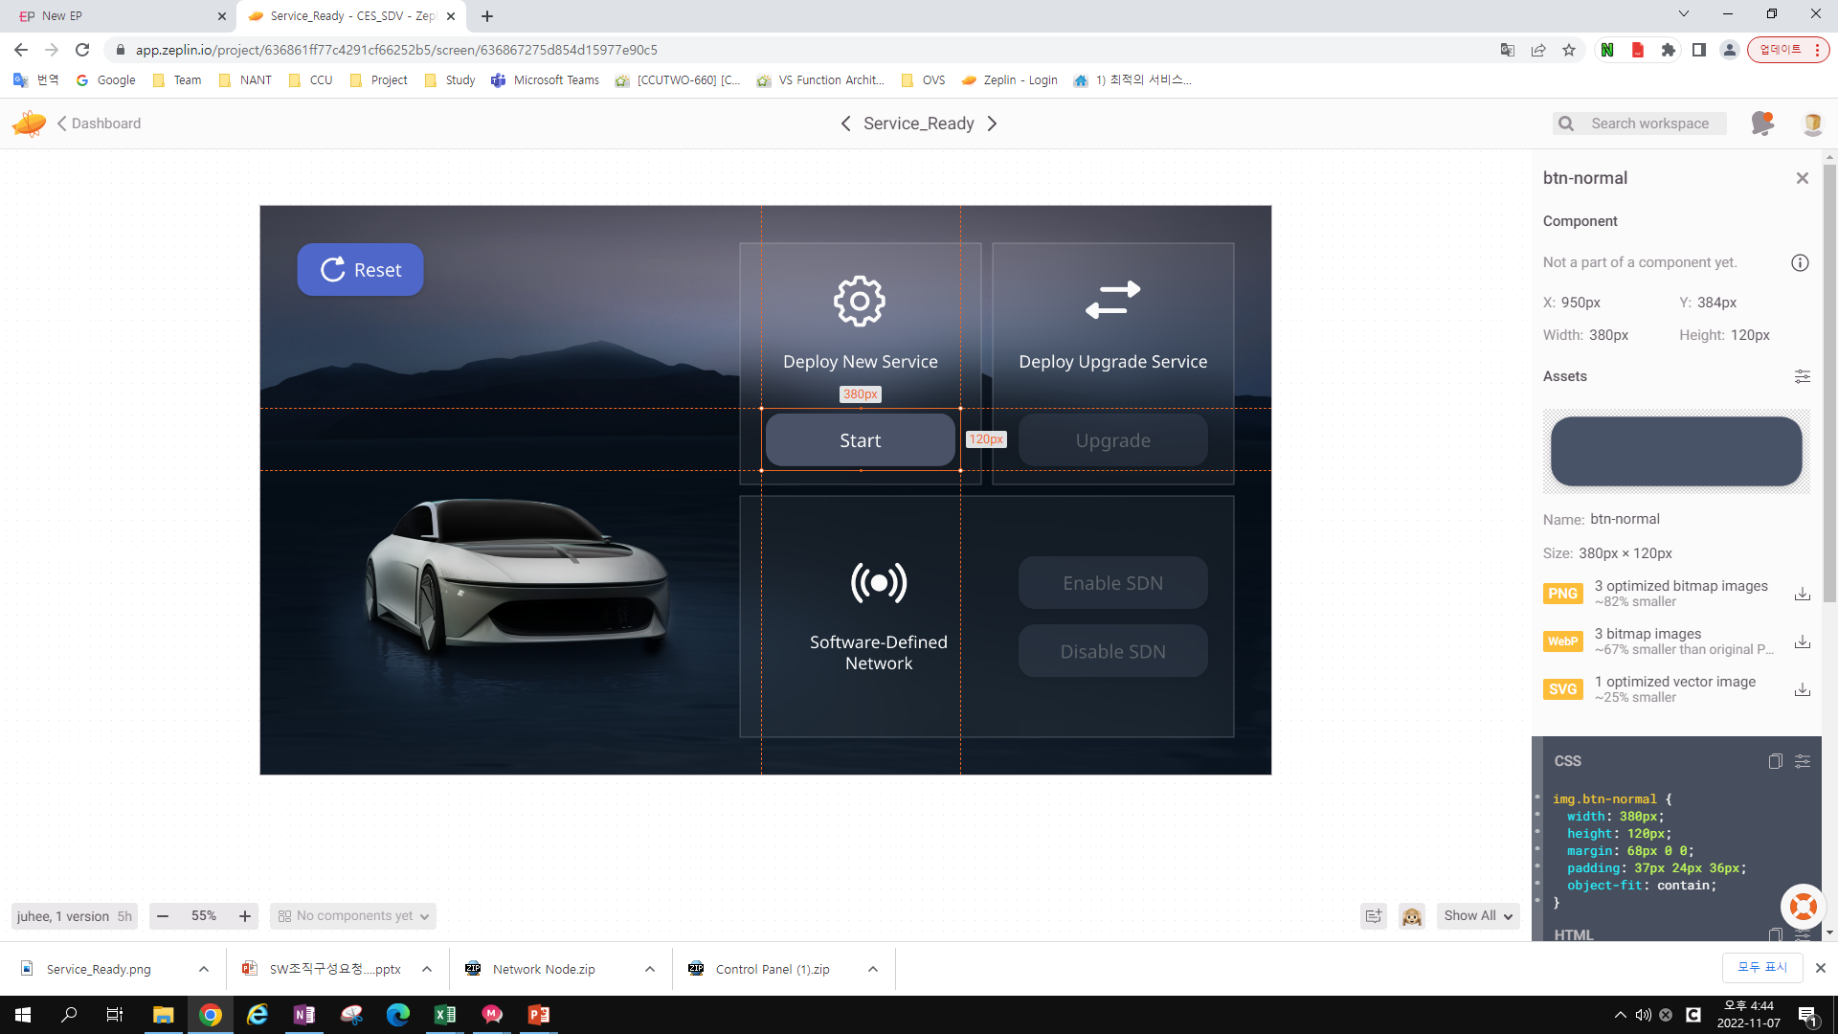

Slide 16
<!-- png -->
<img src="img/btn-normal.png"
srcset="img/btn-normal@2x.png 2x,
img/btn-normal@3x.png 3x"
class="btn-normal">
<!-- svg -->
<img src="img/btn-normal.svg"
class="btn-normal">
<!-- webp -->
<img src="img/btn-normal.webp"
srcset="img/btn-normal@2x.webp 2x,
img/btn-normal@3x.webp 3x"
class="btn-normal">
img.btn-normal {
width: 380px;
height: 120px;
margin: 68px 0 0;
padding: 37px 24px 36px;
object-fit: contain;
}

Slide 17


Slide 18
.main-title {
width: 332px;
height: 47px;
font-family: NotoSans;
font-size: 35px;
font-weight: normal;
font-stretch: normal;
font-style: normal;
line-height: normal;
letter-spacing: normal;
text-align: center;
color: #fafafa;
}
<span class="main-title">
Start
</span>

Slide 19
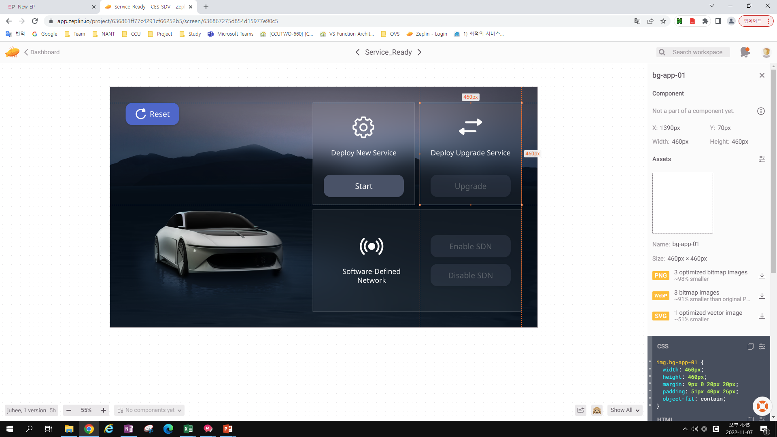

Slide 20
<!-- png -->
<img src="img/bg-app-01.png"
srcset="img/bg-app-01@2x.png 2x,
img/bg-app-01@3x.png 3x"
class="bg-app-01">
<!-- svg -->
<img src="img/bg-app-01.svg"
class="bg-app-01">
<!-- webp -->
<img src="img/bg-app-01.webp"
srcset="img/bg-app-01@2x.webp 2x,
img/bg-app-01@3x.webp 3x"
class="bg-app-01">
img.bg-app-01 {
width: 460px;
height: 460px;
margin: 9px 0 20px 20px;
padding: 51px 40px 26px;
object-fit: contain;
}

Slide 21
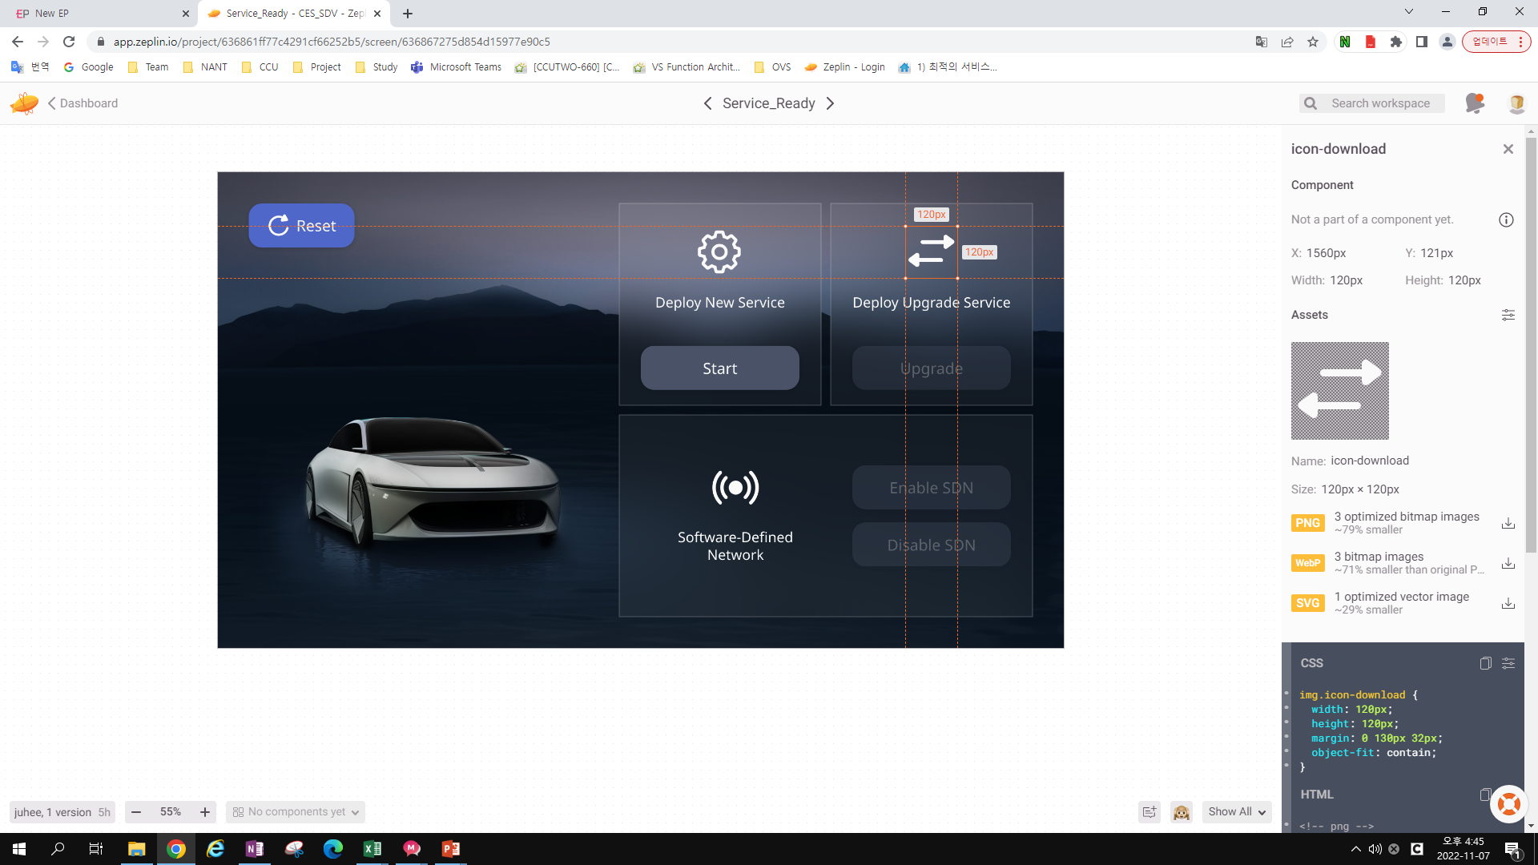

Slide 22
img.icon-download {
width: 120px;
height: 120px;
margin: 0 130px 32px;
object-fit: contain;
}
<!-- png -->
<img src="img/icon-download.png"
srcset="img/icon-download@2x.png 2x,
img/icon-download@3x.png 3x"
class="icon-download">
<!-- svg -->
<img src="img/icon-download.svg"
class="icon-download">
<!-- webp -->
<img src="img/icon-download.webp"
srcset="img/icon-download@2x.webp 2x,
img/icon-download@3x.webp 3x"
class="icon-download">

Slide 23
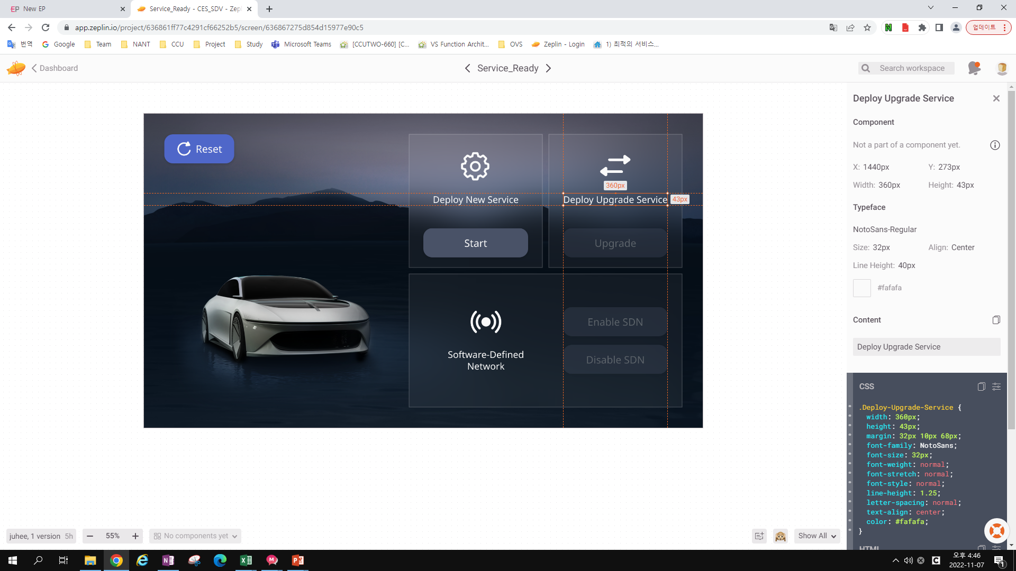

Slide 24
.Deploy-Upgrade-Service {
width: 360px;
height: 43px;
margin: 32px 10px 68px;
font-family: NotoSans;
font-size: 32px;
font-weight: normal;
font-stretch: normal;
font-style: normal;
line-height: 1.25;
letter-spacing: normal;
text-align: center;
color: #fafafa;
}
<span class="Deploy-Upgrade-Service">
Deploy Upgrade Service
</span>

Slide 25
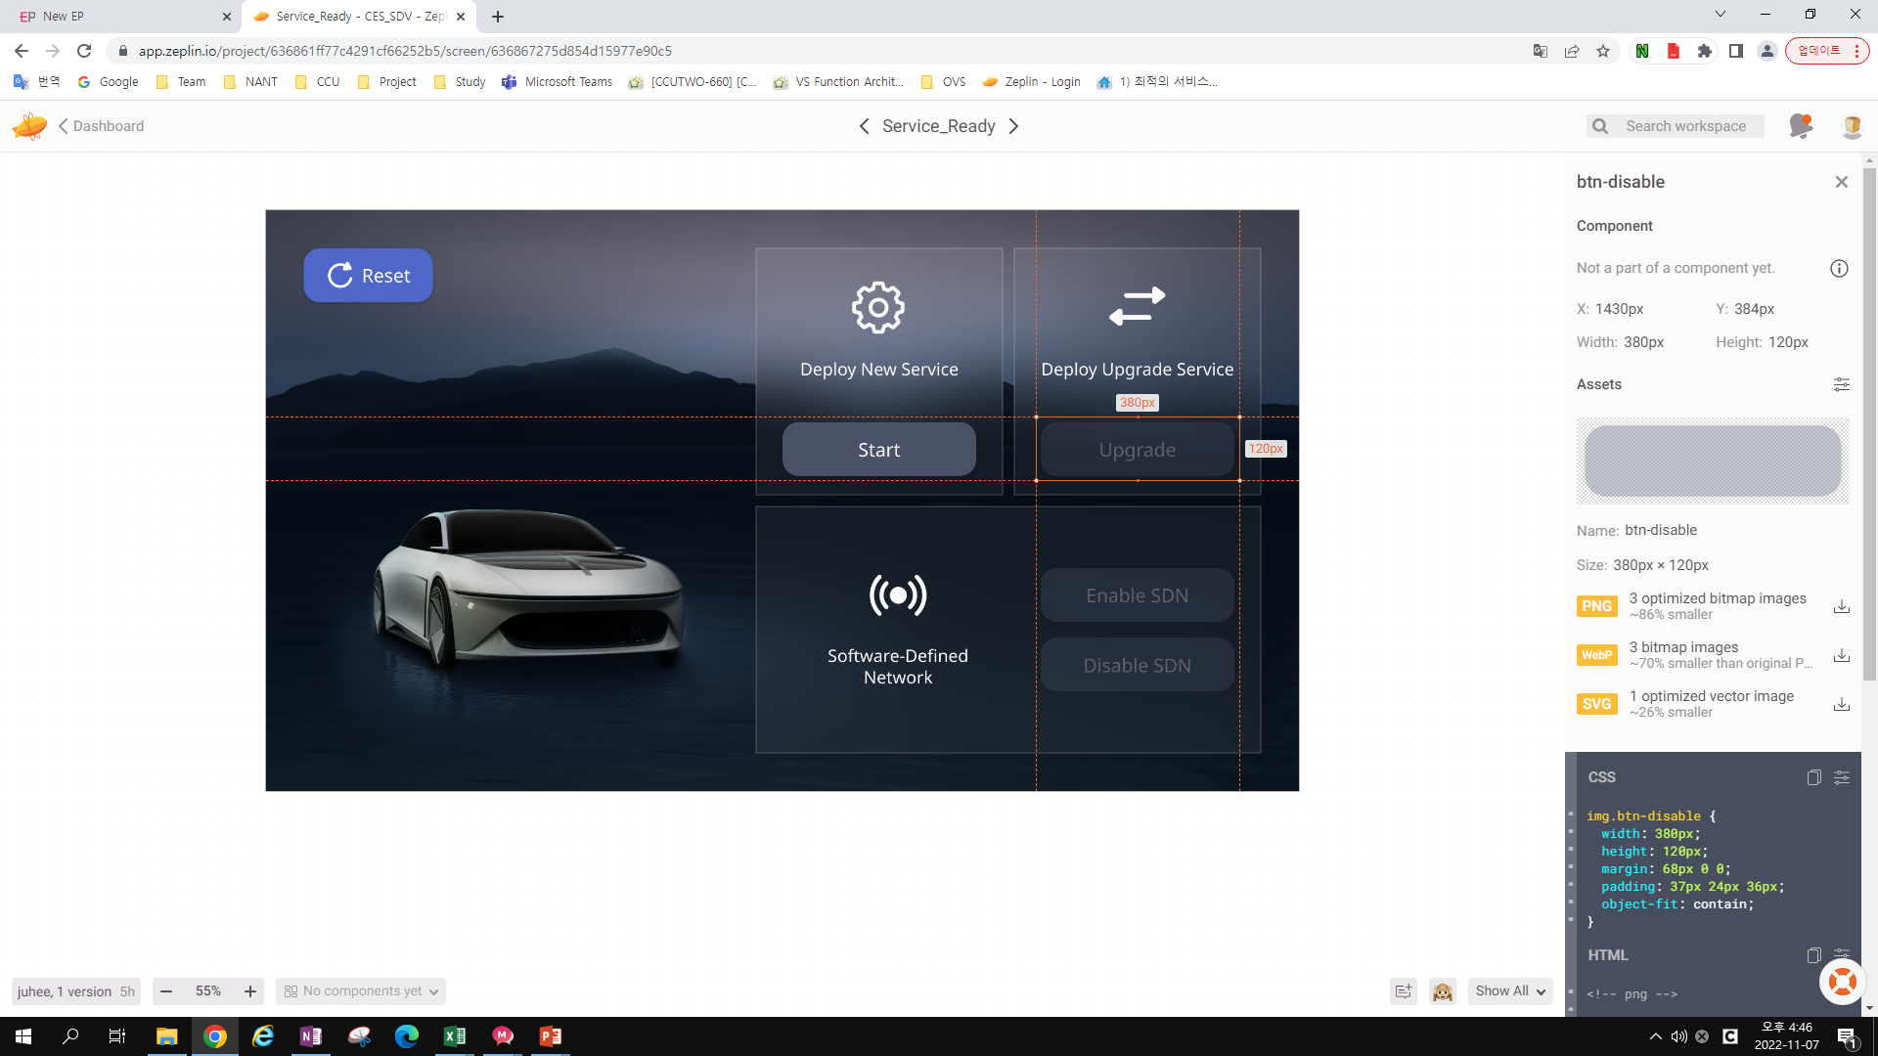

Slide 26
<!-- png -->
<img src="img/btn-disable.png"
srcset="img/btn-disable@2x.png 2x,
img/btn-disable@3x.png 3x"
class="btn-disable">
<!-- svg -->
<img src="img/btn-disable.svg"
class="btn-disable">
<!-- webp -->
<img src="img/btn-disable.webp"
srcset="img/btn-disable@2x.webp 2x,
img/btn-disable@3x.webp 3x"
class="btn-disable">
img.btn-disable {
width: 380px;
height: 120px;
margin: 68px 0 0;
padding: 37px 24px 36px;
object-fit: contain;
}

Slide 27
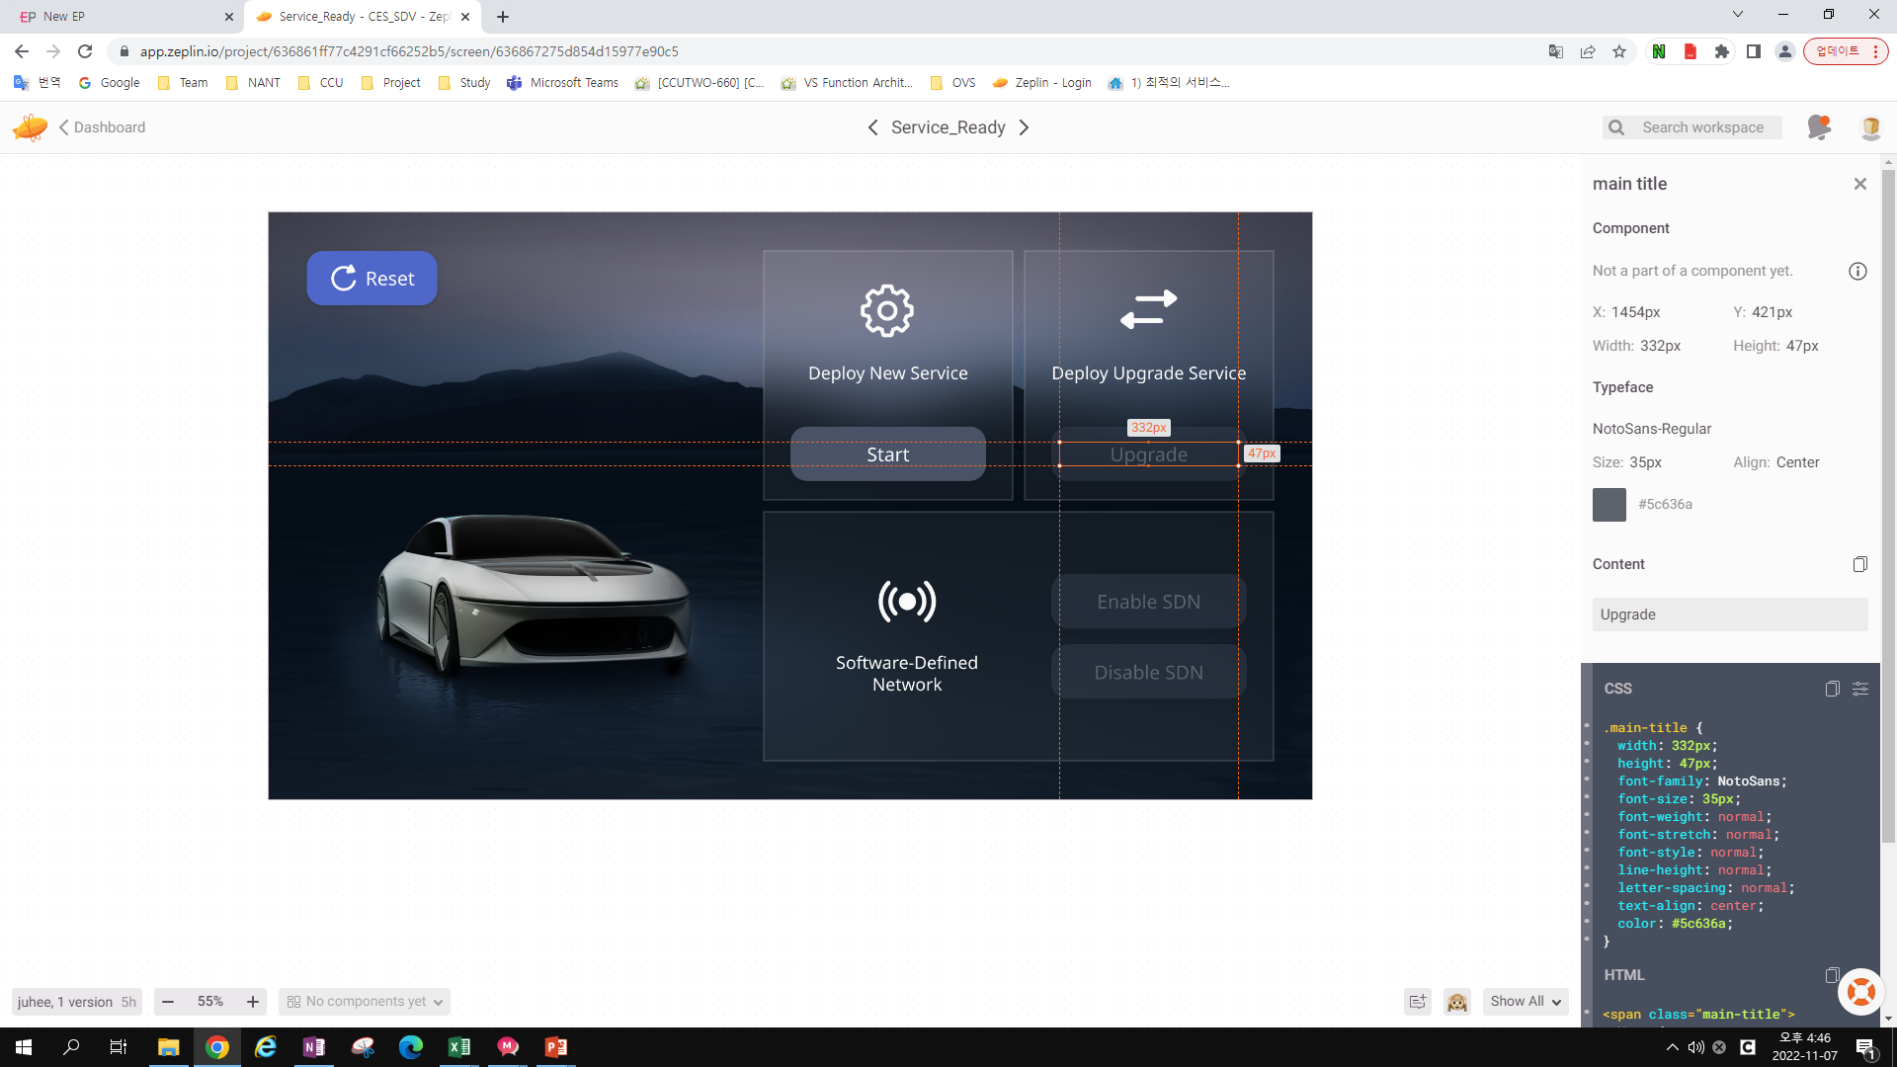

Slide 28
.main-title {
width: 332px;
height: 47px;
font-family: NotoSans;
font-size: 35px;
font-weight: normal;
font-stretch: normal;
font-style: normal;
line-height: normal;
letter-spacing: normal;
text-align: center;
color: #5c636a;
}
<span class="main-title">
Upgrade
</span>

Slide 29
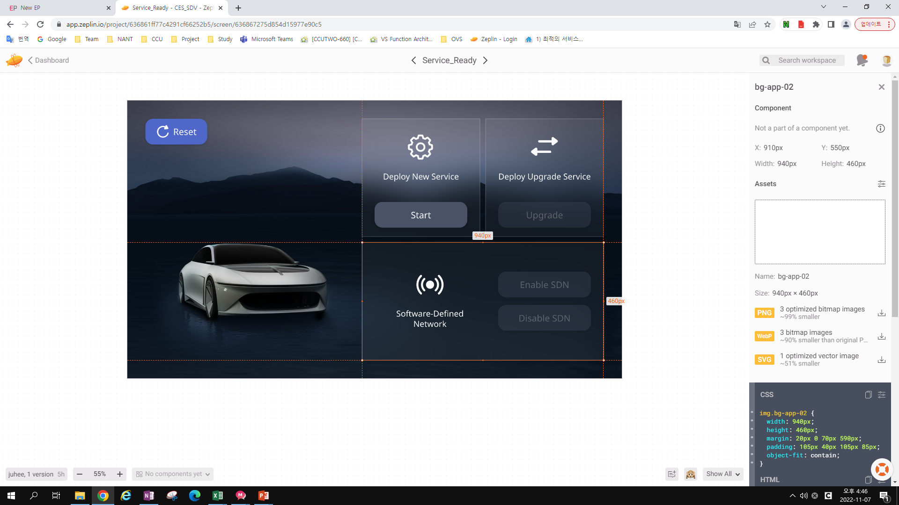

Slide 30
img.bg-app-02 {
width: 940px;
height: 460px;
margin: 20px 0 70px 590px;
padding: 105px 40px 105px 85px;
object-fit: contain;
}
<!-- png -->
<img src="img/bg-app-02.png"
srcset="img/bg-app-02@2x.png 2x,
img/bg-app-02@3x.png 3x"
class="bg-app-02">
<!-- svg -->
<img src="img/bg-app-02.svg"
class="bg-app-02">
<!-- webp -->
<img src="img/bg-app-02.webp"
srcset="img/bg-app-02@2x.webp 2x,
img/bg-app-02@3x.webp 3x"
class="bg-app-02">

Slide 31
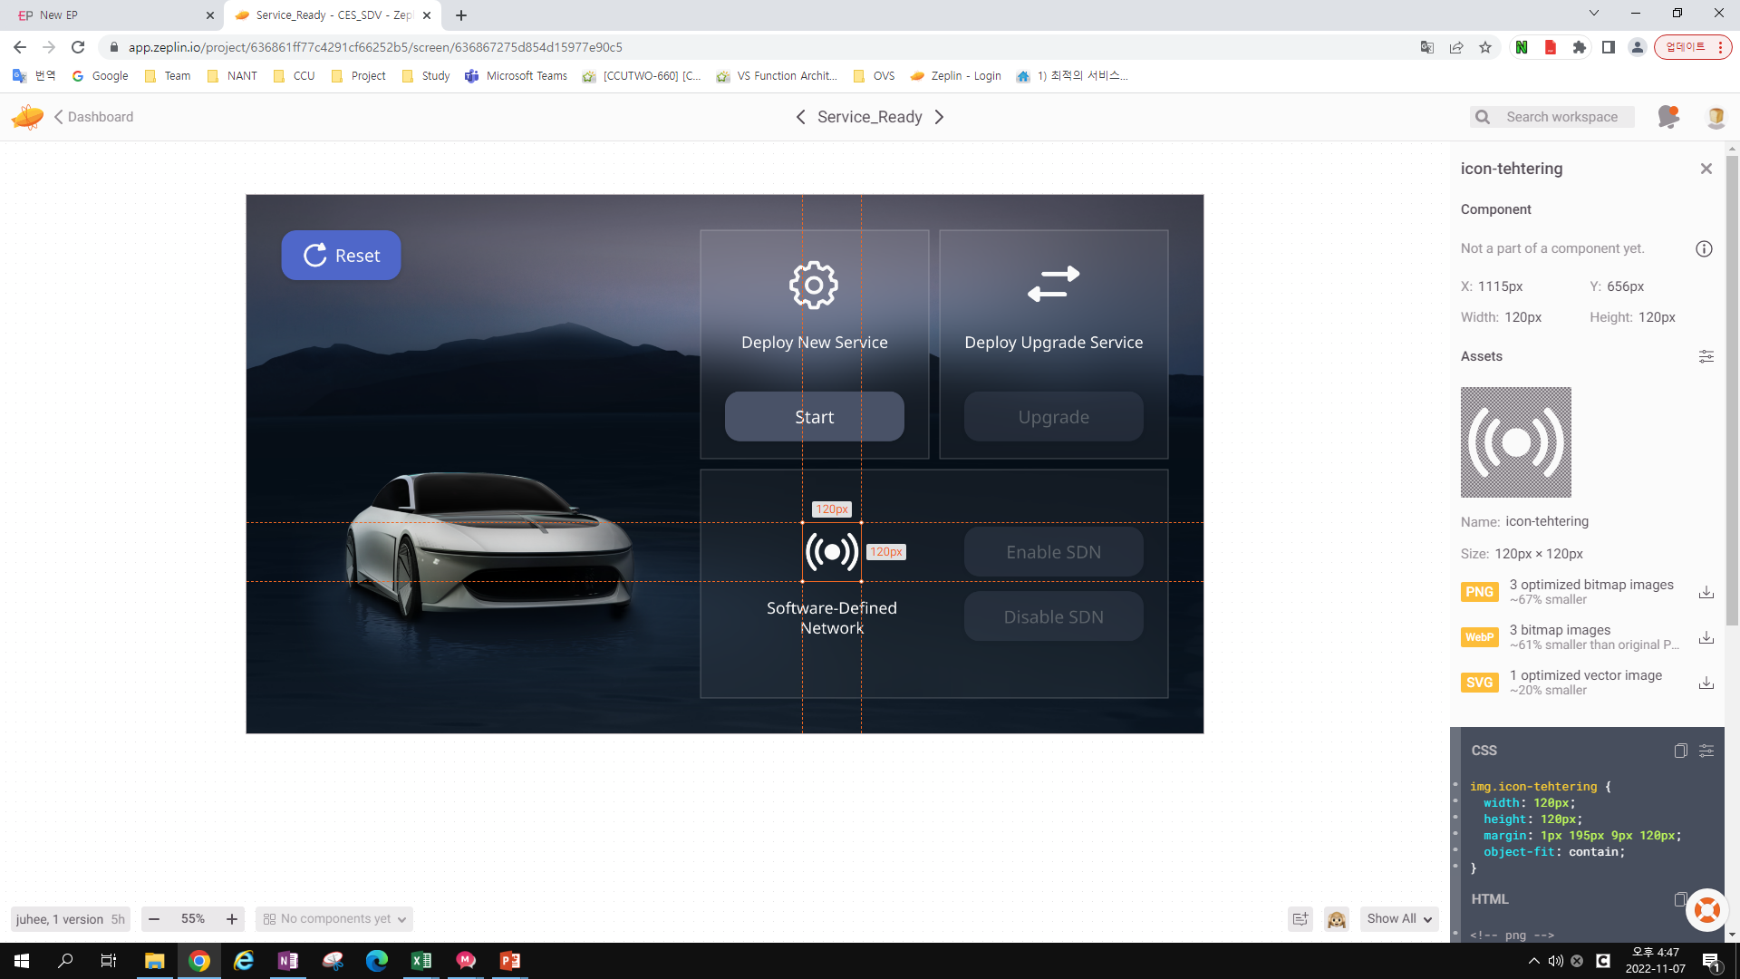

Slide 32
<!-- png -->
<img src="img/icon-tehtering.png"
srcset="img/icon-tehtering@2x.png 2x,
img/icon-tehtering@3x.png 3x"
class="icon-tehtering">
<!-- svg -->
<img src="img/icon-tehtering.svg"
class="icon-tehtering">
<!-- webp -->
<img src="img/icon-tehtering.webp"
srcset="img/icon-tehtering@2x.webp 2x,
img/icon-tehtering@3x.webp 3x"
class="icon-tehtering">
img.icon-tehtering {
width: 120px;
height: 120px;
margin: 1px 195px 9px 120px;
object-fit: contain;
}

Slide 33
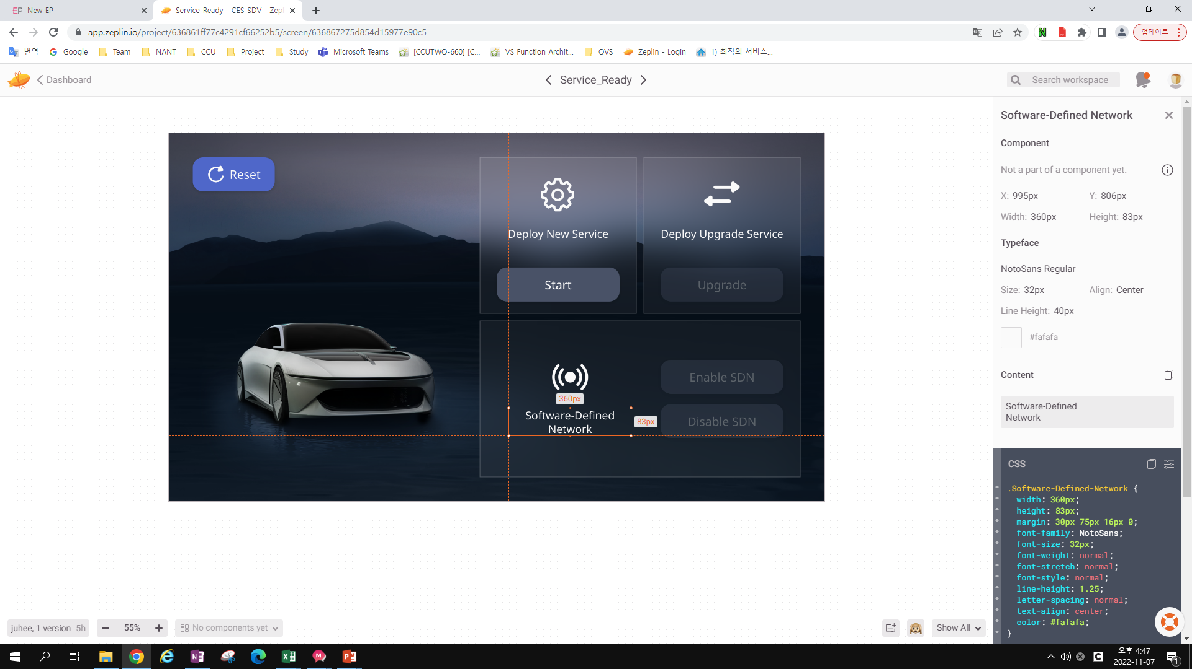

Slide 34
.Software-Defined-Network {
width: 360px;
height: 83px;
margin: 30px 75px 16px 0;
font-family: NotoSans;
font-size: 32px;
font-weight: normal;
font-stretch: normal;
font-style: normal;
line-height: 1.25;
letter-spacing: normal;
text-align: center;
color: #fafafa;
}
<span class="Software-Defined-Network">
Software-Defined
</span>

Slide 35
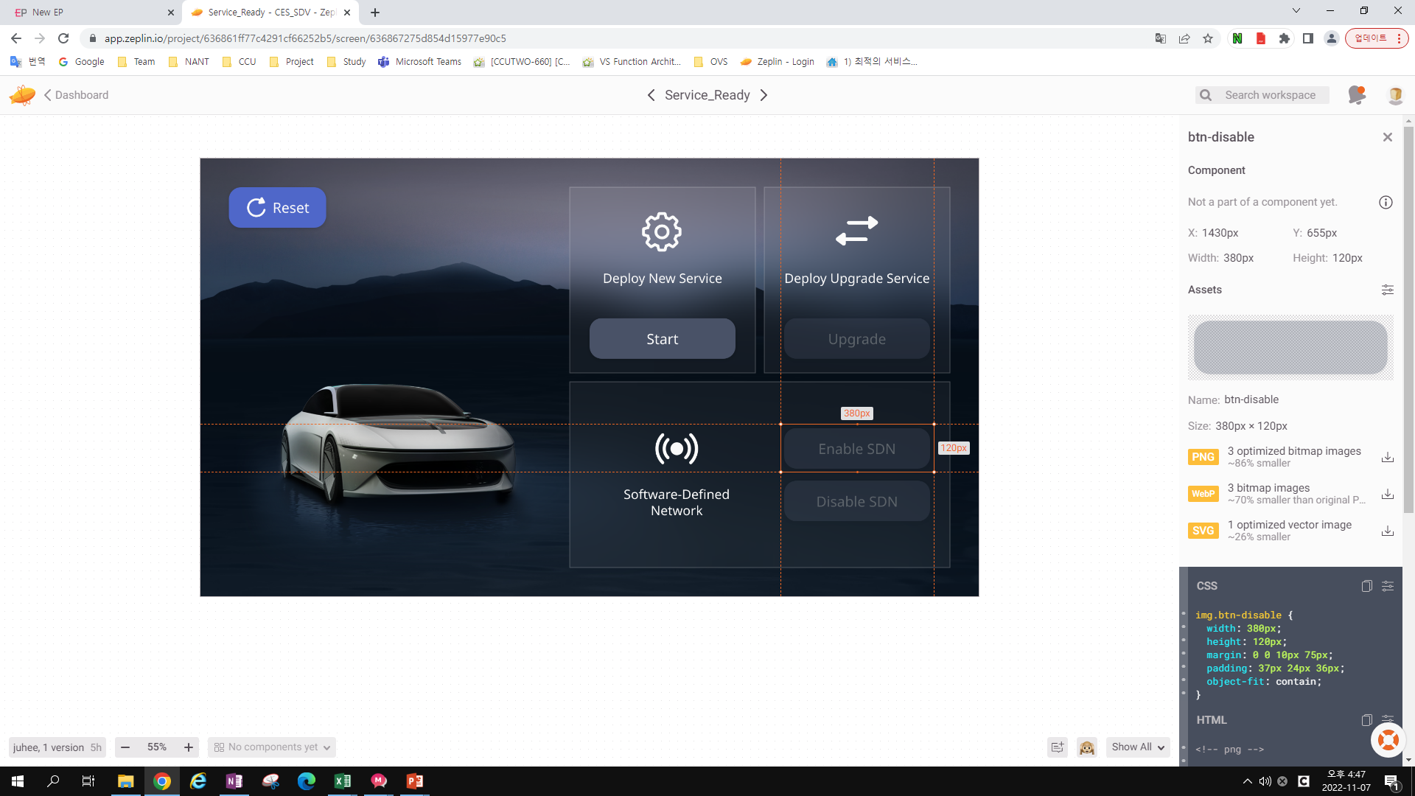

Slide 36
<!-- png -->
<img src="img/btn-disable.png"
srcset="img/btn-disable@2x.png 2x,
img/btn-disable@3x.png 3x"
class="btn-disable">
<!-- svg -->
<img src="img/btn-disable.svg"
class="btn-disable">
<!-- webp -->
<img src="img/btn-disable.webp"
srcset="img/btn-disable@2x.webp 2x,
img/btn-disable@3x.webp 3x"
class="btn-disable">
img.btn-disable {
width: 380px;
height: 120px;
margin: 0 0 10px 75px;
padding: 37px 24px 36px;
object-fit: contain;
}

Slide 37


Slide 38
.main-title {
width: 332px;
height: 47px;
font-family: NotoSans;
font-size: 35px;
font-weight: normal;
font-stretch: normal;
font-style: normal;
line-height: normal;
letter-spacing: normal;
text-align: center;
color: #5c636a;
}
<span class="main-title">
Enable
</span>

Slide 39
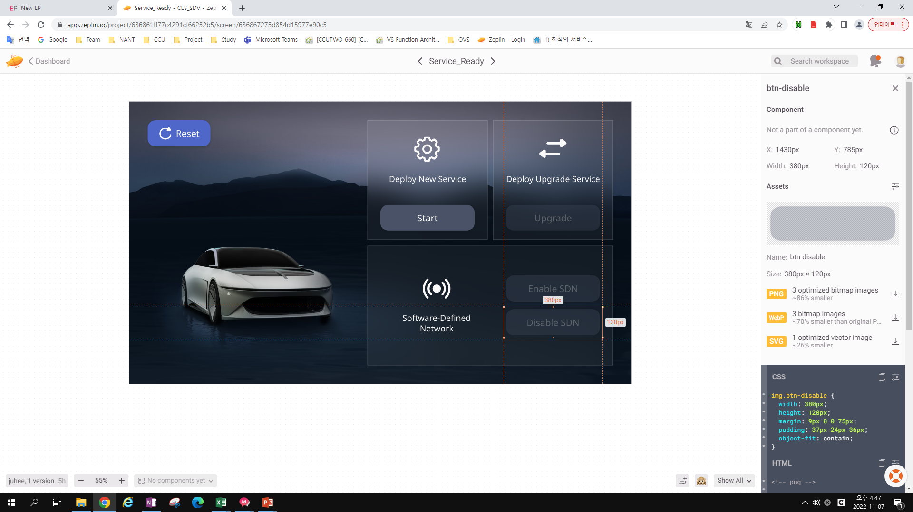

Slide 40
<!-- png -->
<img src="img/btn-disable.png"
srcset="img/btn-disable@2x.png 2x,
img/btn-disable@3x.png 3x"
class="btn-disable">
<!-- svg -->
<img src="img/btn-disable.svg"
class="btn-disable">
<!-- webp -->
<img src="img/btn-disable.webp"
srcset="img/btn-disable@2x.webp 2x,
img/btn-disable@3x.webp 3x"
class="btn-disable">
img.btn-disable {
width: 380px;
height: 120px;
margin: 9px 0 0 75px;
padding: 37px 24px 36px;
object-fit: contain;
}

Slide 41


Slide 42
.main-title {
width: 332px;
height: 47px;
font-family: NotoSans;
font-size: 35px;
font-weight: normal;
font-stretch: normal;
font-style: normal;
line-height: normal;
letter-spacing: normal;
text-align: center;
color: #5c636a;
}
<span class="main-title">
Disable
</span>

Slide 43
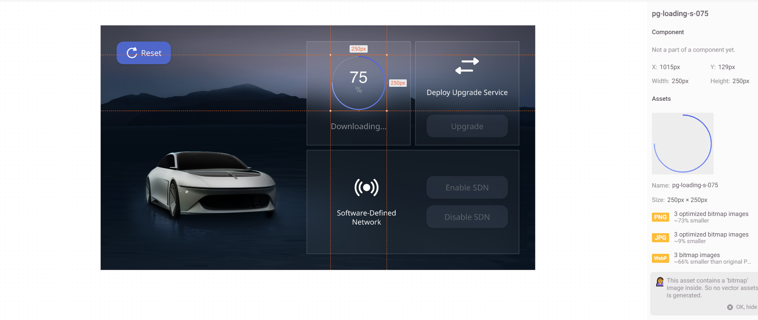

Slide 44
img.pg-loading-s-075 {
width: 250px;
height: 250px;
margin: 0 41px 42px;
padding: 69px 35px 75px;
object-fit: contain;
}
<!-- jpg -->
<img src="img/pg-loading-s-075.jpg"
srcset="img/pg-loading-s-075@2x.jpg 2x,
img/pg-loading-s-075@3x.jpg 3x"
class="pg-loading-s-075">
<!-- png -->
<img src="img/pg-loading-s-075.png"
srcset="img/pg-loading-s-075@2x.png 2x,
img/pg-loading-s-075@3x.png 3x"
class="pg-loading-s-075">
<!-- webp -->
<img src="img/pg-loading-s-075.webp"
srcset="img/pg-loading-s-075@2x.webp 2x,
img/pg-loading-s-075@3x.webp 3x"
class="pg-loading-s-075">

Slide 45
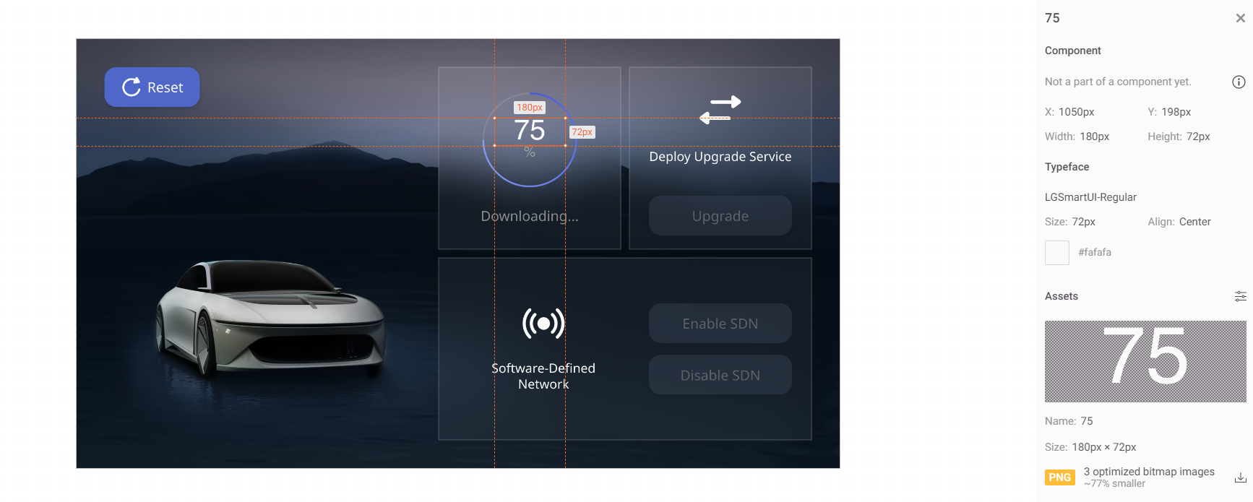

Slide 46
img {
width: 180px;
height: 72px;
margin: 0 0 34px;
object-fit: contain;
font-family: LGSmartUI;
font-size: 72px;
font-weight: normal;
font-stretch: normal;
font-style: normal;
line-height: normal;
letter-spacing: normal;
text-align: center;
color: #fafafa;
}
<span>
75
</span>

Slide 47
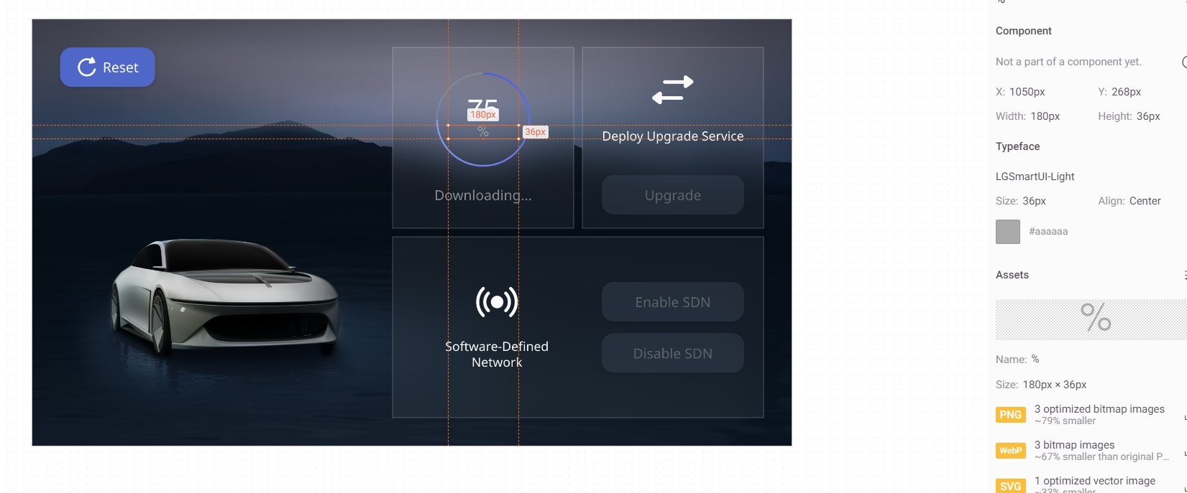

Slide 48
img {
width: 180px;
height: 36px;
margin: 70px 0 0;
object-fit: contain;
font-family: LGSmartUI;
font-size: 36px;
font-weight: 300;
font-stretch: normal;
font-style: normal;
line-height: normal;
letter-spacing: normal;
text-align: center;
color: #aaa;
}
<span>
%
</span>

Slide 49
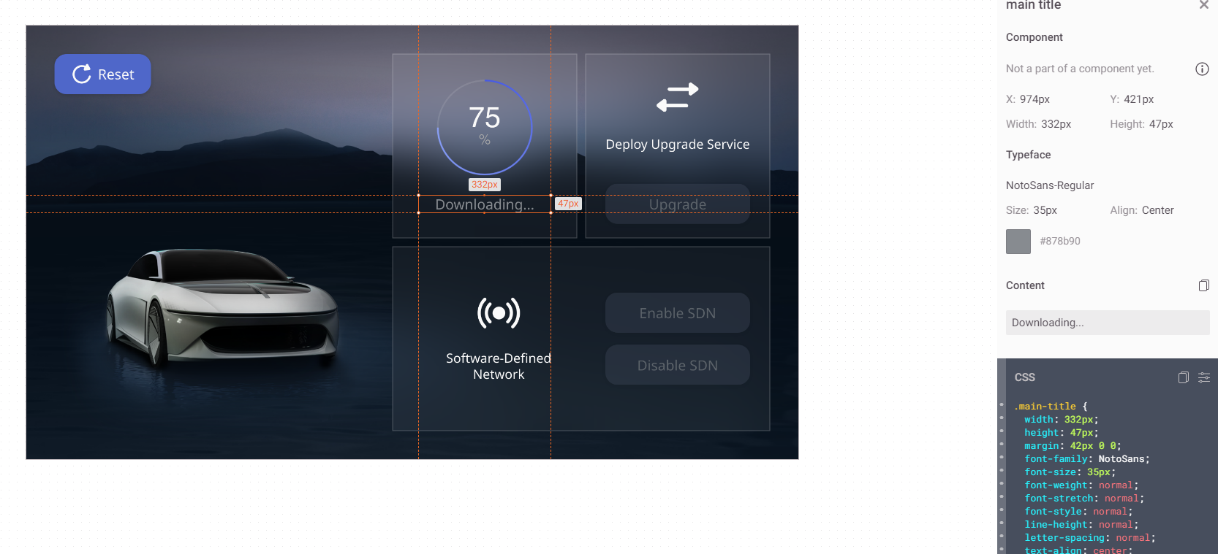

Slide 50
.main-title {
width: 332px;
height: 47px;
margin: 42px 0 0;
font-family: NotoSans;
font-size: 35px;
font-weight: normal;
font-stretch: normal;
font-style: normal;
line-height: normal;
letter-spacing: normal;
text-align: center;
color: #878b90;
}
<span class="main-title">
Downloa
</span>

Slide 51
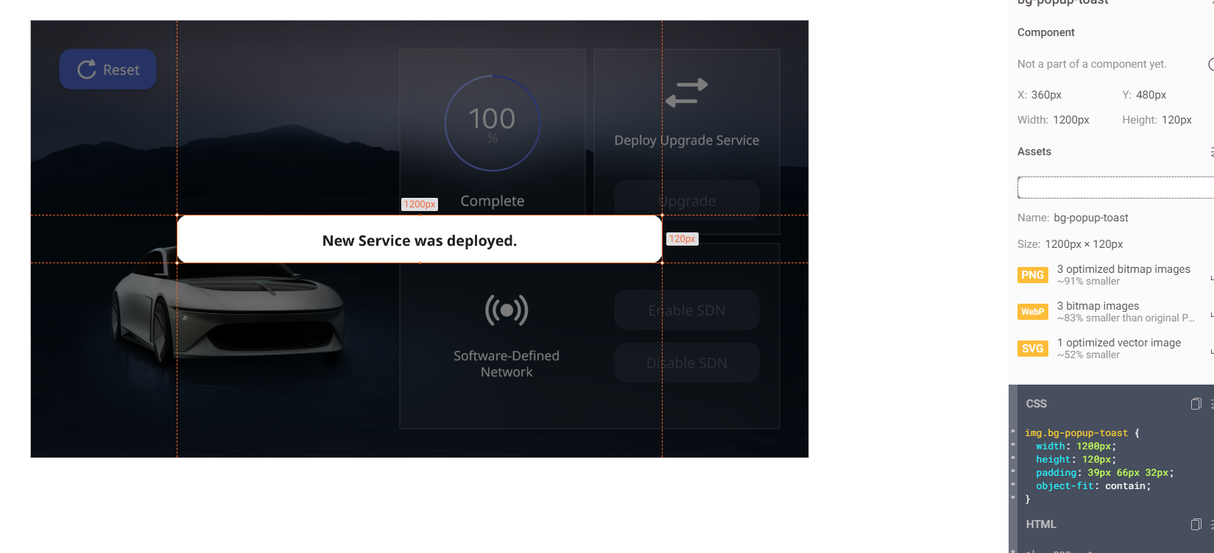

Slide 52
img.bg-popup-toast {
width: 1200px;
height: 120px;
padding: 39px 66px 32px;
object-fit: contain;
}
<!-- png -->
<img src="img/bg-popup-toast.png"
srcset="img/bg-popup-toast@2x.png 2x,
img/bg-popup-toast@3x.png 3x"
class="bg-popup-toast">
<!-- svg -->
<img src="img/bg-popup-toast.svg"
class="bg-popup-toast">
<!-- webp -->
<img src="img/bg-popup-toast.webp"
srcset="img/bg-popup-toast@2x.webp 2x,
img/bg-popup-toast@3x.webp 3x"
class="bg-popup-toast">

Slide 53
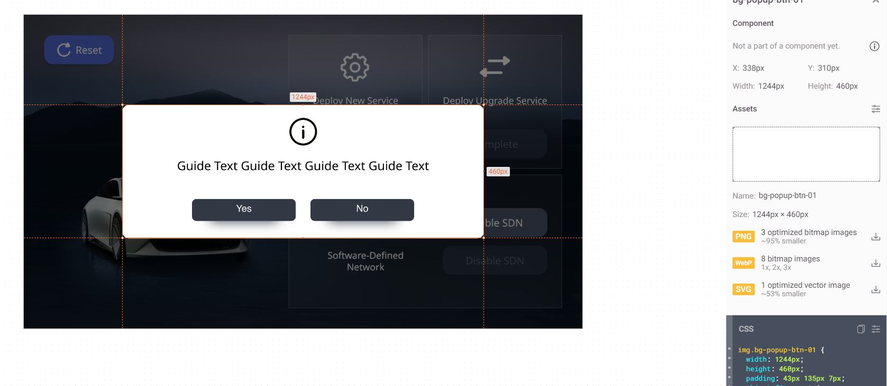

Slide 54
<!-- png -->
<img src="img/bg-popup-btn-01.png"
srcset="img/bg-popup-btn-01@2x.png 2x,
img/bg-popup-btn-01@3x.png 3x"
class="bg-popup-btn-01">
<!-- svg -->
<img src="img/bg-popup-btn-01.svg"
class="bg-popup-btn-01">
<!-- webp -->
<img src="img/bg-popup-btn-01.webp"
srcset="img/bg-popup-btn-01@2x.webp 2x,
img/bg-popup-btn-01@3x.webp 3x"
class="bg-popup-btn-01">
img.bg-popup-btn-01 {
width: 1244px;
height: 460px;
padding: 43px 135px 7px;
object-fit: contain;
}

Slide 55
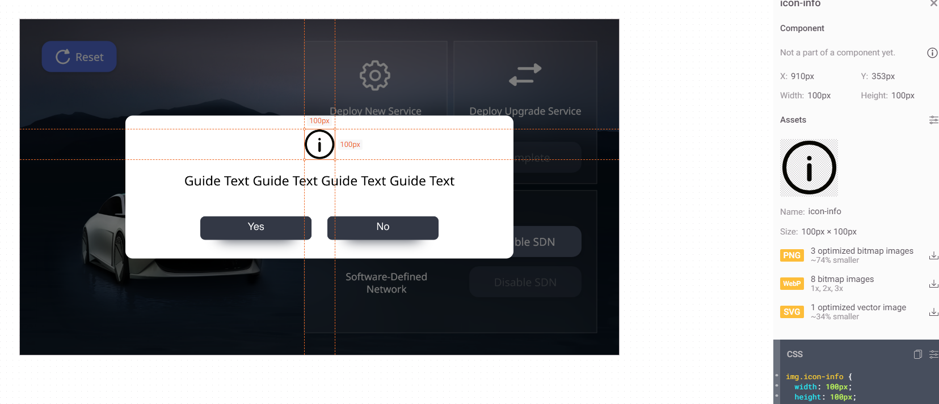

Slide 56
<!-- png -->
<img src="img/icon-info.png"
srcset="img/icon-info@2x.png 2x,
img/icon-info@3x.png 3x"
class="icon-info">
<!-- svg -->
<img src="img/icon-info.svg"
class="icon-info">
<!-- webp -->
<img src="img/icon-info.webp"
srcset="img/icon-info@2x.webp 2x,
img/icon-info@3x.webp 3x"
class="icon-info">
img.icon-info {
width: 100px;
height: 100px;
margin: 0 437px 37px;
object-fit: contain;
}

Slide 57
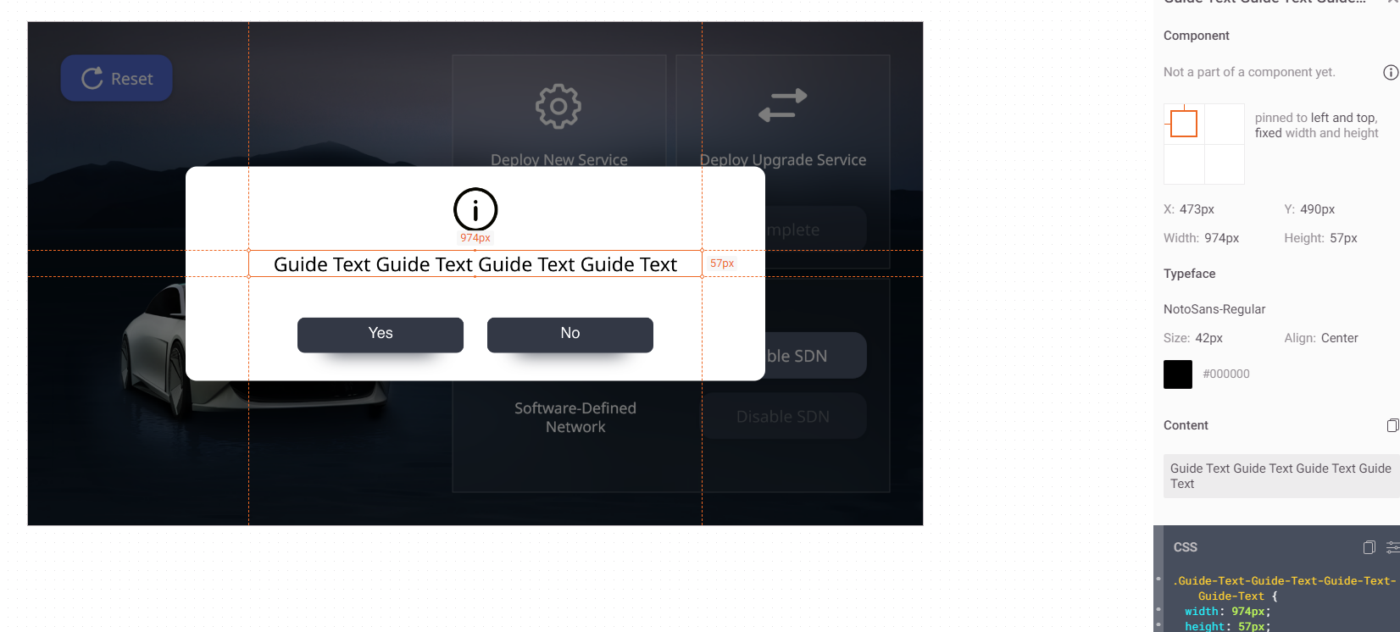

Slide 58
.Guide-Text-Guide-Text-Guide-Text-Guide-Text {
width: 974px;
height: 57px;
margin: 37px 0 86px;
font-family: NotoSans;
font-size: 42px;
font-weight: normal;
font-stretch: normal;
font-style: normal;
line-height: normal;
letter-spacing: normal;
text-align: center;
color: #000;
}
<span class="Guide-Text-Guide-Text-Guide-Text-Guide-Text">
Guide Text Guide Te
</span>

Slide 59
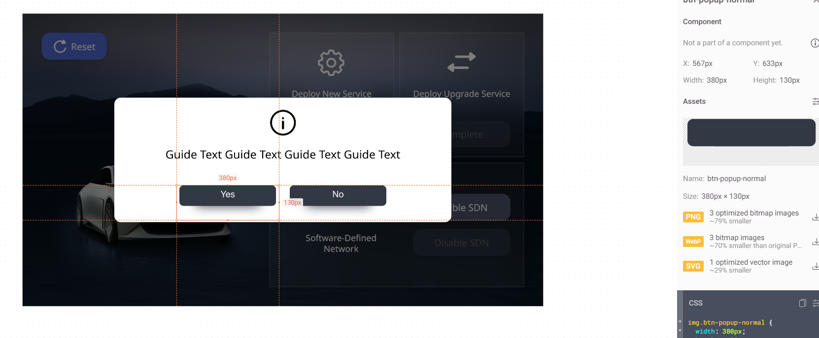

Slide 60
<!-- png -->
<img src="img/btn-popup-normal.png"
srcset="img/btn-popup-normal@2x.png 2x,
img/btn-popup-normal@3x.png 3x"
class="btn-popup-normal">
<!-- svg -->
<img src="img/btn-popup-normal.svg"
class="btn-popup-normal">
<!-- webp -->
<img src="img/btn-popup-normal.webp"
srcset="img/btn-popup-normal@2x.webp 2x,
img/btn-popup-normal@3x.webp 3x"
class="btn-popup-normal">
img.btn-popup-normal {
width: 380px;
height: 130px;
margin: 86px 27px 0 94px;
padding: 20px 90px 77px 89px;
object-fit: contain;
}

Slide 61
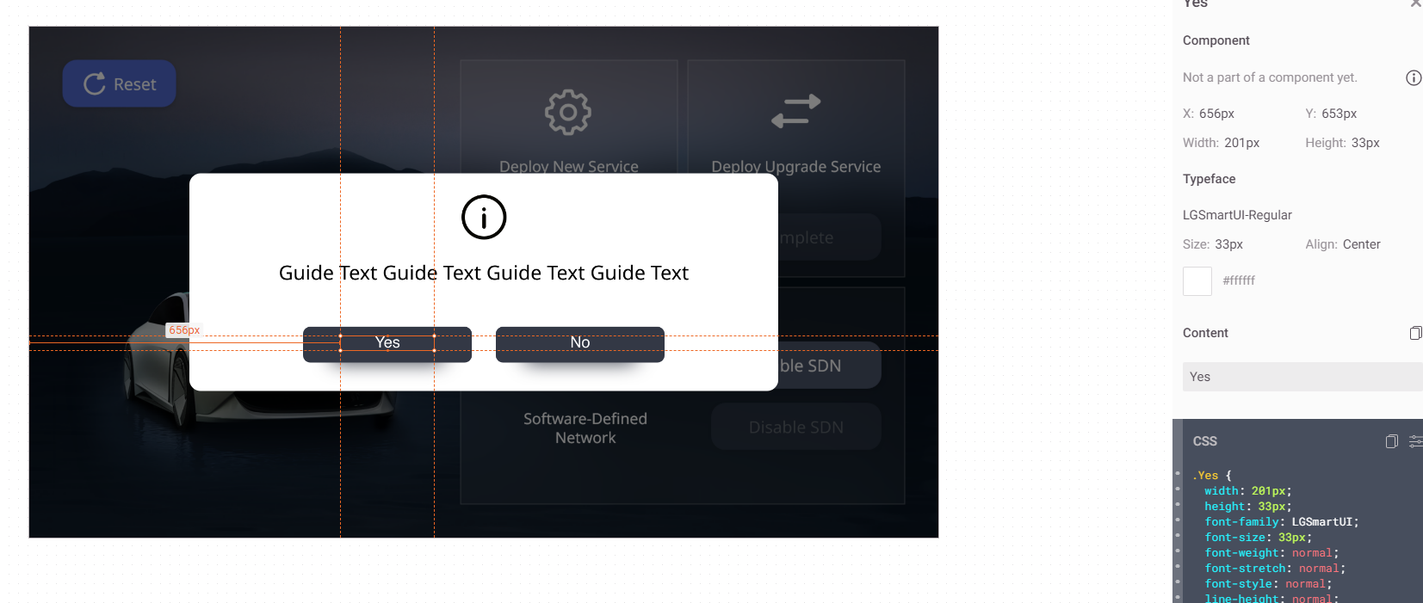

Slide 62
.Yes {
width: 201px;
height: 33px;
font-family: LGSmartUI;
font-size: 33px;
font-weight: normal;
font-stretch: normal;
font-style: normal;
line-height: normal;
letter-spacing: normal;
text-align: center;
color: #fff;
}
<span class="Yes">
Yes
</span>

Slide 63
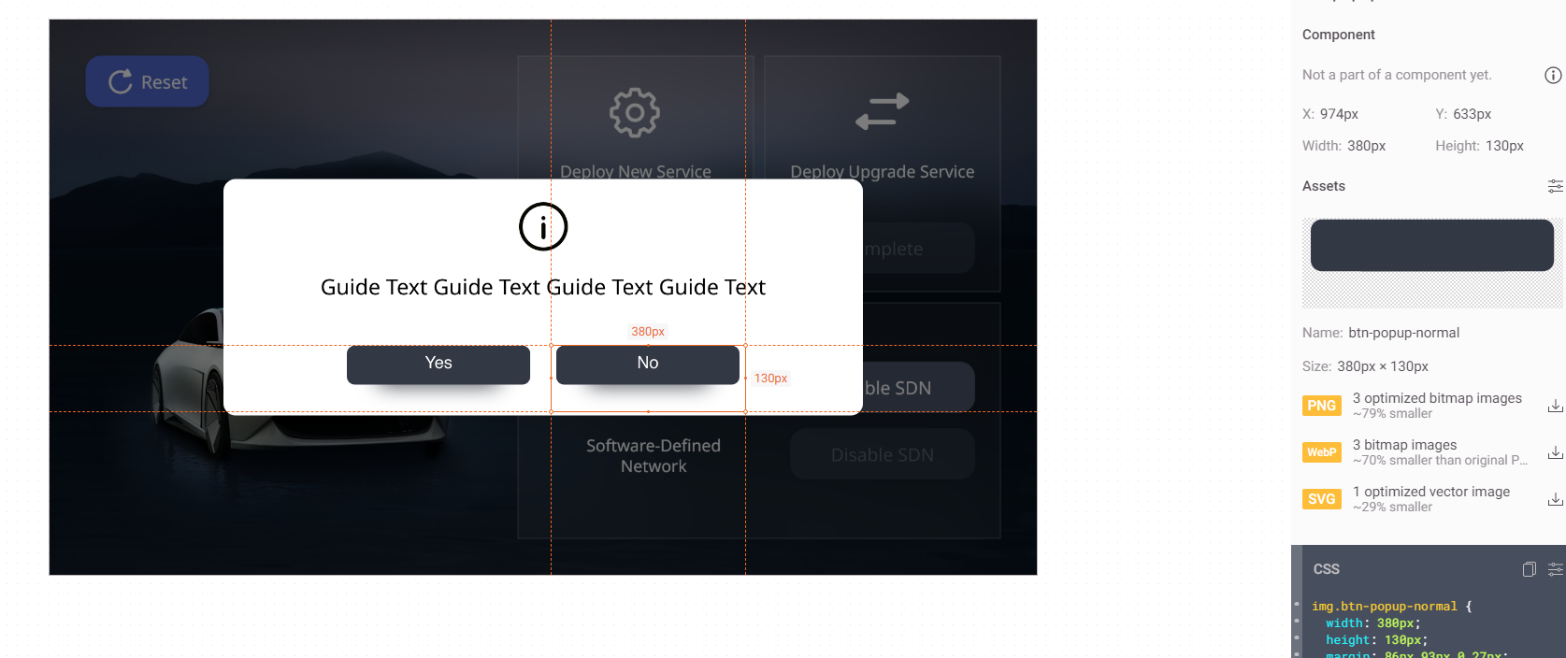

Slide 64
<!-- png -->
<img src="img/btn-popup-normal.png"
srcset="img/btn-popup-normal@2x.png 2x,
img/btn-popup-normal@3x.png 3x"
class="btn-popup-normal">
<!-- svg -->
<img src="img/btn-popup-normal.svg"
class="btn-popup-normal">
<!-- webp -->
<img src="img/btn-popup-normal.webp"
srcset="img/btn-popup-normal@2x.webp 2x,
img/btn-popup-normal@3x.webp 3x"
class="btn-popup-normal">
img.btn-popup-normal {
width: 380px;
height: 130px;
margin: 86px 93px 0 27px;
padding: 20px 90px 77px 89px;
object-fit: contain;
}

Slide 65
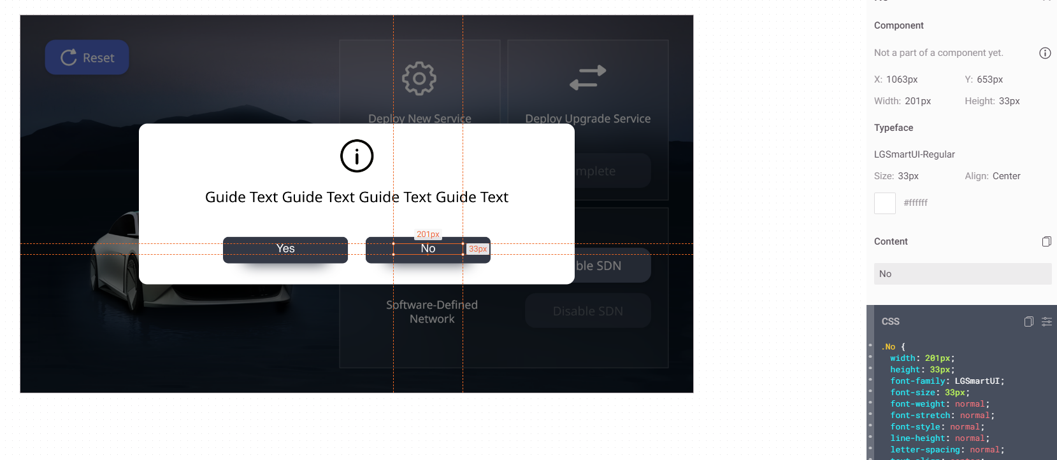

Slide 66
.No {
width: 201px;
height: 33px;
font-family: LGSmartUI;
font-size: 33px;
font-weight: normal;
font-stretch: normal;
font-style: normal;
line-height: normal;
letter-spacing: normal;
text-align: center;
color: #fff;
}
<span class="No">
No
</span>

